Slide 1

Hackathon Qualification Description

Slide 2

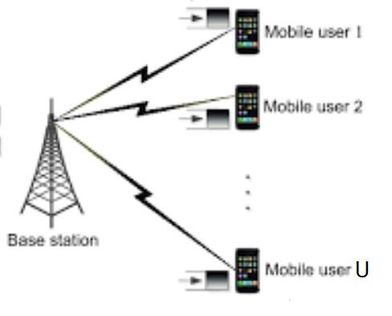
Downlink channel allocation problem
Many users connected to a base station need to send and receive data in real-time.
As we have limited bandwidth, efficient allocation of data channel resources to the users has a significant impact on the quality of experience of the users.
Here, we focus on the simplified version of the downlink data channel allocation problem as a key building block of mobile networks.

Slide 3
Background
5G massive MIMO resources can be divided into M*N grids where in each grid only a single user can be placed.
We can have multiple instances of each user based on the size of its data. A user with bigger size of data potentially needs more instances (more grids) to send its data. For example, in the following figure, we have 5 instances of user U1, 3 instances of U2 and 2 instances of U3.
We cannot place more than one instance of the same user in the same column, for example, two U1s cannot be placed in the same column. But we can have multiple instances of the same user in the same row.
U1
U1
U1
U1
U1
U1
U2
U2
U2
U3
U3
User U3 is alone, nobody affects it
Rows (Lines or Layers)
Couldn’t insert double U1 in the same column
User U1 and U2 affect each other
User U1 and U3 affect each other
M: Number of rows
N: Number of Columns
U: Set of users, {U1, U2, …}
|U|: Number of users
Columns (number of frequencies )

Slide 4
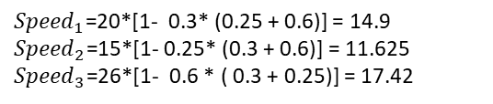




Problem statement
Each user is denoted by a tuple including: {initial speed, data size, factor}
Initial speed: the speed of sending the user’s data when there is no conflict with other users
Data size: the total amount of data that the user wants to send.
Factor: the factor by which the data speed of the user reduces as a result of collocating with other users in the same column.
For example, we can have three users as follows:
U1={20, 5000,0.3}, This means that user U1 wants to send 5000 bytes data and if there is no conflict with other users the data will be sent by speed 20.
U2={15,3500,0.25},
U3={26,4200,0.6}
The number of instances of each user depends on both the size of its data and the speed. When a user’s data cannot be sent entirely in a single grid, it needs multiple grids.
Users placed in the same column negatively affect each other in terms of data speed, while users on the same row have no effect on each other.
The speed of each user in case of not collocating with other users is equal to its initial speed, however, in case of collocating with other users in the same column, it is reduced to
$${Speed}_{i }={initial_Speed}_{i }∗\text{(}\text{1 }\text{–} {collocated_factor}_{i }\text{)}$$
Where:
${collocated_factor}_{i }=$ ${factor}_{i }∗\sum_{∀ Users j≠i assigned to the same column}{{factor}_{j }}$
Note 1: The speed cannot be zero. Thus, if ${Speed}_{i }$leads to a negative value (i.e., the collocated factor gets bigger than 1), consider the speed equal to zero.
For a single column and three users, we can have four different scenarios where the users speeds are calculated as follows:
U1
${Speed}_{1}$ = ${initial_Speed}_{1 }$= 20
U1
${Speed}_{1}$=20*(1-0.3*0.6) = 16.4
${Speed}_{3}$=26*(1-0.3*0.6) = 21.32
U1
${Speed}_{1}$=20*(1-0.3*0.25) = 18.5
${Speed}_{2}$=15*(1-0.3*0.25) = 13.875
U1
${Speed}_{1}$=20*[1- 0.3* (0.25 + 0.6)] = 14.9
${Speed}_{2}$=15*[1- 0.25* (0.3 + 0.6)] = 11.625
${Speed}_{3}$=26*[1- 0.6 * ( 0.3 + 0.25)] = 17.42
U3
U2
U2
U3

Slide 5
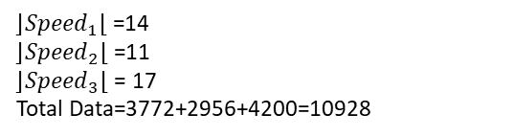


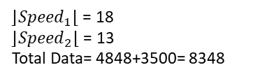
Mapping speed to data transmission rate
There is a corresponding relationship between the speed and the amount of data that a user can send, shown by the speed to data map table. Here is an example of such a table.
For example, when the speed of a user is 8, 2158 bytes data can be sent.
Notes: To map the speed to data, use the given F function than rounds the speed considering the floating point error. For example, if the speed U1 collocated with U2 is 10.65, its data is 2696.
Note 2: the F function is not exactly the same as the know round function because it may roundup a number which is extremly close to the next integer number to avoid the effect of floating point error, for example if the speed is 12.999999, F functions returns 13 rather than 12.
For the example in the previous slide, the data sent by each user, in each scenario is calculated as follows:
U1={20, 5000,0.3}, U2={15,3500,0.25}, U3={26,4200,0.6}
Speed | 0 | 1 | 2 | 3 | 4 | 5 | 6 | 7 | 8 | 9 | 10 | 11 | 12 | 13 | 14 | 15 | 16 | 17 | 18 | 19 | 20 | 21 | 22 | 23 | 24 | 25 | 26
Data | 0 | 275 | 544 | 813 | 1082 | 1351 | 1620 | 1889 | 2158 | 2427 | 2696 | 2965 | 3234 | 3503 | 3772 | 4041 | 4310 | 4579 | 4848 | 5117 | 5386 | 5655 | 5924 | 6193 | 6462 | 6731 | 7000
U1
⌊${Speed}_{1}$⌋= 20
Total Data=5000
U1
⌊${Speed}_{1}$⌋ = 16
⌊${Speed}_{3}$⌋= 21
Total Data=4310 + 4200=8510
U1
⌊${Speed}_{1}$⌋ = 18
⌊${Speed}_{2}$⌋ = 13
Total Data= 4848+3500= 8348
U1
⌊${Speed}_{1}$⌋ =14
⌊${Speed}_{2}$⌋ =11
⌊${Speed}_{3}$⌋ = 17
Total Data=3772+2956+4200=10928
U3
U2
U2
U3
Note: although U3 has speed 21 and can send 5655 bytes, but its buffer size is 4200 bytes.
Note: although U2 has speed 13 and can send 3503 bytes, but its buffer size is 3500 bytes.
Note: although U3 has speed 17 and can send 4579 bytes, but its buffer size is 4200 bytes.

Slide 6




Objective and Constraints
Objective: Maximise the sum of average speed of all users (${Avg_Speed}_{i }$), formulated as
$Where BestSpeedUsers is sum of maximum speed of all users and can be calculated by$
$Indeed objective function is a float number between 0 and 1$
Constraint: More than one instance of the same user cannot be placed in the same column.
Penalty term: As we would like to send all the data, we apply a penalty term that shows which portion of total data of all users cannot be sent ($Data_Loss$). Indeed, the penalty term is a float number in range 0 to 1, where 0 indicates no data loss. A solution with zero data loss is called as ‘feasible solution’.
${Objective_function}_{ }=$ $\frac{\sum_{∀ Users}{{Avg_Speed}_{i }}}{BestSpeedUsers}$
$$\sum_{∀ Users}{{Init_Speed}_{i }}$$
Penalty_term $=\frac{\sum_{∀ Users}{{Data_Loss}_{i}}}{Total_Data_of_All_Users}$
$Total_Data_of_All_Users=Sum of total data size of all users$

Slide 7
Score Function
The Score_function includes both the objective and the penalty function. It is formulated as:
Where:
The best scores are achived when the penalty term is zero, which in this case the score is equal to the objective function. The worst value of score is achived when all the data is lost, which in this case the score is equal to –α.
Range of score is [–α , 1]
${Score}_{ }={Objective_function}_{ }−α∗Penalty_term$
$α=Data loss penalty coefficient set by the system designer based on the importance of data users loss. The value of alpha$
$is given in each the test case.$

Slide 8
Limitations
Write a code in C++ or Python that can find a placement for all the test cases,
The execution time of the code, for each test case, should be less than 1 second on your own machine.
Only basic libraries can be used, using optimization libraries/tools are not allowed.
Note:
At the end of the qualification phase, to validate the codes, we check the execution time of your codes on a VM with
Intel processor 3.0 GHz eight-cores and 16GB RAM.
If the execution time of your code on the VM is far more than 1 second, it is counted as an invalid solution. As most of today's laptops are not more powerful than the considered VM, if the execution time of your code is in the scale of a few milliseconds on your laptop, you can ensure that it doesn't take longer on the considered VM.

Slide 9

Input and Output Data
Input:
A speed to data map as a csv file, used for all test cases
A set of input files each of which corresponds to a test case where each test case includes
Grid size (M, N)
Number of users (|U|)
Value of $α$
Users’ information (initial speed, data size, factor)
Submission file: It should be a zip file including:
a. A csv file for each test case that includes:
Grid placement
Penalty_term
Objective_function
Score
Execution time of the code
b. A single source file with either .py or .cpp or .cc extension

Slide 10
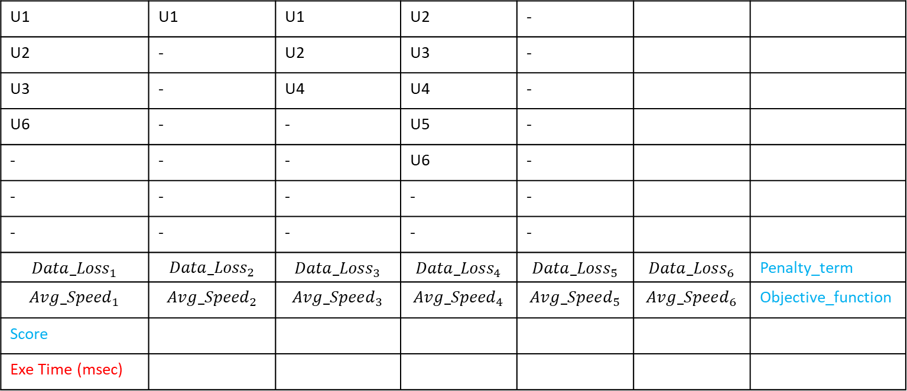
Output CSV Template
The first part is called ASSIGNMENT PART that includes M rows, number 0 to M-1. This part is used for showing assigment of users to grids. The next part is called as COMPLEMENTARY PART including four next rows, used to show data loss, user speeds, the goal function value, and the execution time of the algorithm respectively. Here we assume we have only 6 users U1, U2, U3, U4, U5 and U6. But generally we could have any given number of users.
Please use comma ’,’ as the seprator of the elements, not other sybmols. We don’t need a comma at the end of rows. Please also use a dash ’-’ to show empty grids in the assignment part, but for other empty parts dash is not needed.
As noted in the example, the number of columns of the csv file could be bigger than N. Indeed, it is equal to Max (N , |U|+1)
N
0
1
2
3
4
...
M-1
M
M+1
M+2
M+3
 |  | - | U2 | U1 | U1 | U1
 |  | - | U3 | U2 | - | U2
 |  | - | U4 | U4 | - | U3
 |  | - | U5 | - | - | U6
 |  | - | U6 | - | - | -
 |  | - | - | - | - | -
 |  | - | - | - | - | -
Penalty_term | $${Data_Loss}_{6}$$ | $${Data_Loss}_{5}$$ | $${Data_Loss}_{4}$$ | $${Data_Loss}_{3}$$ | $${Data_Loss}_{2}$$ | $${Data_Loss}_{1}$$
Objective_function | $${Avg_Speed}_{6}$$ | $${Avg_Speed}_{5}$$ | $${Avg_Speed}_{4}$$ | $${Avg_Speed}_{3}$$ | $${Avg_Speed}_{2}$$ | $${Avg_Speed}_{1}$$
 |  |  |  |  |  | Score
 |  |  |  |  |  | Exe Time (msec)
M

Slide 11
Testcases
We have 13 test cases (named as tc1 to tc13) with different grid size, number of users, and difficulty levels.
The following is an example input test case .csv file:
2,5 -> Input grid size (Number of Rows (M) and Columns (N), respectively)
4 -> Total number of users
100 -> Value of 𝛼
1 21 4000 85 -> Users’ information (User ID, Initial speed, Data size, Factor Percentage which is a number between 1 and 100)
2 18 2800 75
3 19 3900 5
4 25 4500 50

Slide 12
Evaluation in Leaderboard
We primarily rank the teams based on the number of feasible submitted test-cases
A team with more number of feasible test-cases gets higher position in the leaderboard
In case of equal number of feasible test-cases:
The team with more number of valid submitted test-cases gets higher position,
In case of equal number of submitted test-cases and the same number of feasible test-cases,
The team with higher total score (sum of score of all submitted solutions) gets higher positions in the leaderboard
In case of equal number of submitted test-cases, the same number of feasible test-cases, also equal total scores, the shorter sum of execution times is prioritised.
Notes:
A valid submission is the submission that passes all the requirements in terms of file name, file type, size, layout of the csv file and correct calculations of score, objective, penalty term while the execution time of the program is less than 1 second. Otherwise, it is an invalid solution.
An infeasible solution is a valid solution with a non-zero value of the penalty term.
A Feasible solution is a valid solution with zero value of the penalty term.

Slide 13

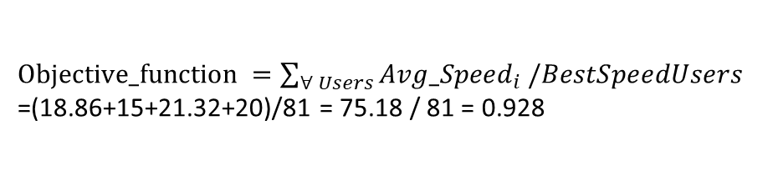










Example 1
U1={20,5000,0.3}, U2={15,3500,0.25}, U3={26,4200,0.6}, U4={20,10000,0.2}; $α$ = 1000
Speed | 0 | 1 | 2 | 3 | 4 | 5 | 6 | 7 | 8 | 9 | 10 | 11 | 12 | 13 | 14 | 15 | 16 | 17 | 18 | 19 | 20 | 21 | 22 | 23 | 24 | 25 | 26
Data | 0 | 275 | 544 | 813 | 1082 | 1351 | 1620 | 1889 | 2158 | 2427 | 2696 | 2965 | 3234 | 3503 | 3772 | 4041 | 4310 | 4579 | 4848 | 5117 | 5386 | 5655 | 5924 | 6193 | 6462 | 6731 | 7000
U3
U4
U4
U1
U2
U1
${Speed}_{1}$=20*(1-0.3*0.6)= 16.4
${Speed}_{3}$=26*(1-0.3*0.6)= 21.32
${Total_Data}_{1}$= 4310
${Total_Data}_{3}$= 4200
${Speed}_{4}$=20*(1-0.2*0)= 20
${Total_Data}_{4}$= 5386
${Speed}_{4}$=20*(1-0.2*0)= 20
${Total_Data}_{4}$= 10000
${Speed}_{1}$=20*(1-0.3*0)= 20
${Total_Data}_{1}$= 5000
${Speed}_{2}$=15*(1-0.25*0)= 15
${Total_Data}_{2}$= 3500
${Objective_function}_{ }=\sum_{∀ Users}{{Avg_Speed}_{i }/BestSpeedUsers}$
=(18.86+15+21.32+20)/81 = 75.18 / 81 = 0.928
$${Avg_Speed}_{1}=\frac{\left(16.4+21.32\right)}{2}=18.86$$
$${Penalty_term}_{ }=0$$
${Score}_{ }={Objective_function}_{ }−α∗0$ = 0.928
$${Avg_Speed}_{2}=15$$
$${Avg_Speed}_{3}=21.32$$
$${Avg_Speed}_{4}=\frac{\left(20+20\right)}{2}=20$$
Indeed, it is a feasible solution that achives 92.8% of the maximum speed

Slide 14

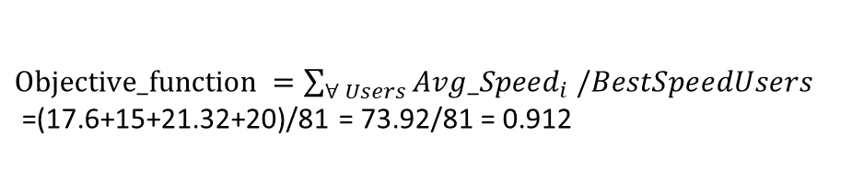
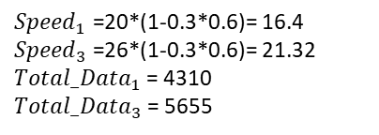



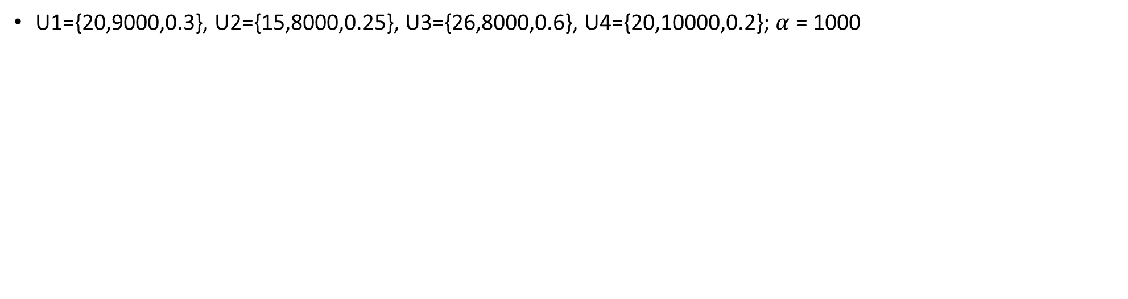
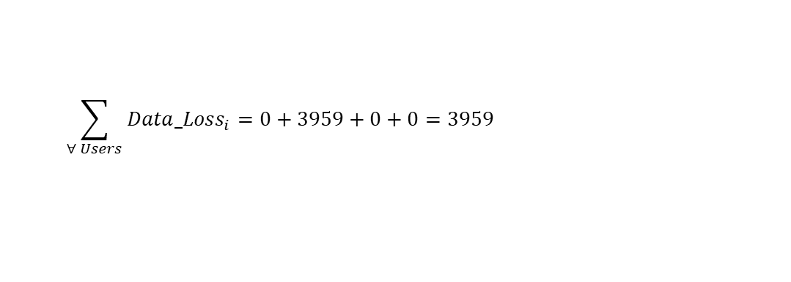





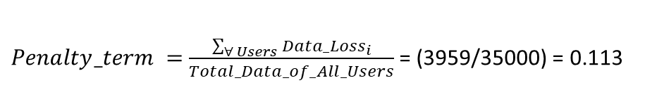
Example 2
U1={20,9000,0.3}, U2={15,8000,0.25}, U3={26,8000,0.6}, U4={20,10000,0.2}; $α$ = 1000
Speed | 0 | 1 | 2 | 3 | 4 | 5 | 6 | 7 | 8 | 9 | 10 | 11 | 12 | 13 | 14 | 15 | 16 | 17 | 18 | 19 | 20 | 21 | 22 | 23 | 24 | 25 | 26
Data | 0 | 275 | 544 | 813 | 1082 | 1351 | 1620 | 1889 | 2158 | 2427 | 2696 | 2965 | 3234 | 3503 | 3772 | 4041 | 4310 | 4579 | 4848 | 5117 | 5386 | 5655 | 5924 | 6193 | 6462 | 6731 | 7000
${Speed}_{1}$=20*(1-0.3*0.6)= 16.4
${Speed}_{3}$=26*(1-0.3*0.6)= 21.32
${Total_Data}_{1}$= 4310
${Total_Data}_{3}$= 5655
${Speed}_{1}$=20*(1-0.3*0.6)= 16.4
${Speed}_{3}$=26*(1-0.3*0.6)= 21.32
${Total_Data}_{1}$= 4310
${Total_Data}_{3}$= 8000
${Speed}_{1}$=20*(1-0.3*0)= 20
${Total_Data}_{1}$= 9000
U3
U3
U1
U4
U4
U2
U1
U1
${Speed}_{4}$=20*(1-0.2*0)= 20
${Total_Data}_{4}$= 5386
${Speed}_{4}$=20*(1-0.2*0)= 20
${Total_Data}_{4}$= 10000
${Speed}_{2}$=15*(1-0.25*0)= 15
${Total_Data}_{2}$= 4041
Max Column = 6
$${Data_Loss}_{2}=8000−4041=3959$$
$$\sum_{∀ Users}{{Data_Loss}_{i}}=0+3959+0+0=3959$$
$${Avg_Speed}_{1}=\frac{\left(16.4+16.4+20\right)}{3}=17.6$$
$Total_Data_of_All_Users$ = 9000+8000+8000+10000= 35000
${Penalty_term}_{ }=$ $\frac{\sum_{∀ Users}{{Data_Loss}_{i}}}{Total_Data_of_All_Users}$ = (3959/35000) = 0.113
$${Avg_Speed}_{2}=15$$
${Objective_function}_{ }=\sum_{∀ Users}{{Avg_Speed}_{i }/BestSpeedUsers}$
=(17.6+15+21.32+20)/81 = 73.92/81 = 0.912
$${Avg_Speed}_{3}=\frac{\left(21.32+21.32\right)}{2}=21.32$$
${Score}_{ }={Objective_function}_{ }−α∗Penalty_term$
= 0.912 – 0.113 * 1000 = -112.088
$${Avg_Speed}_{4}=\frac{\left(20+20\right)}{2}=20$$
Indeed, it is an infeasible solution that couldn’t send 11.3% of all users’ data

